Slide 1
Supply Chain Delay Analysis
Professional Power BI Presentation

Slide 2
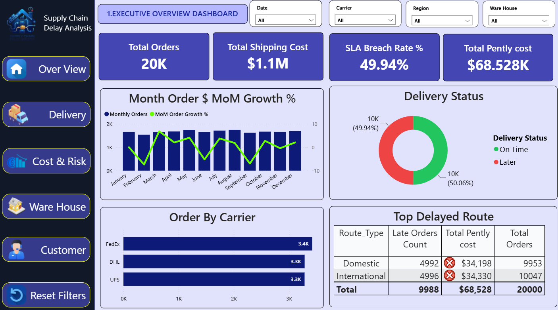
Executive Overview Dashboard
This dashboard gives a complete overview of the supply chain performance. • Total orders are 20K • Shipping cost is 1.1 million dollars • SLA breach rate is 49.94% • Total penalty cost is 68.5K dollars FedEx handled the highest number of orders. This dashboard helps management quickly understand supply chain performance.

Slide 3
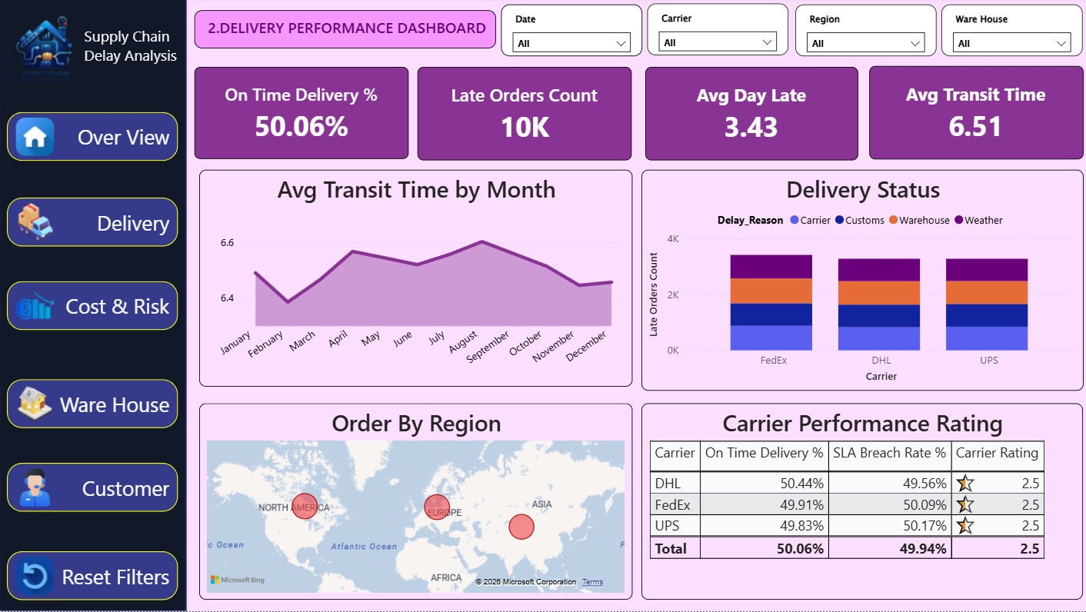
Delivery Performance Dashboard
This dashboard focuses on delivery performance. • On-time delivery percentage is 50.06% • Average delay is 3.43 days • Average transit time is 6.51 days Weather, customs, warehouse, and carrier issues caused delays. This dashboard helps identify delivery bottlenecks.

Slide 4
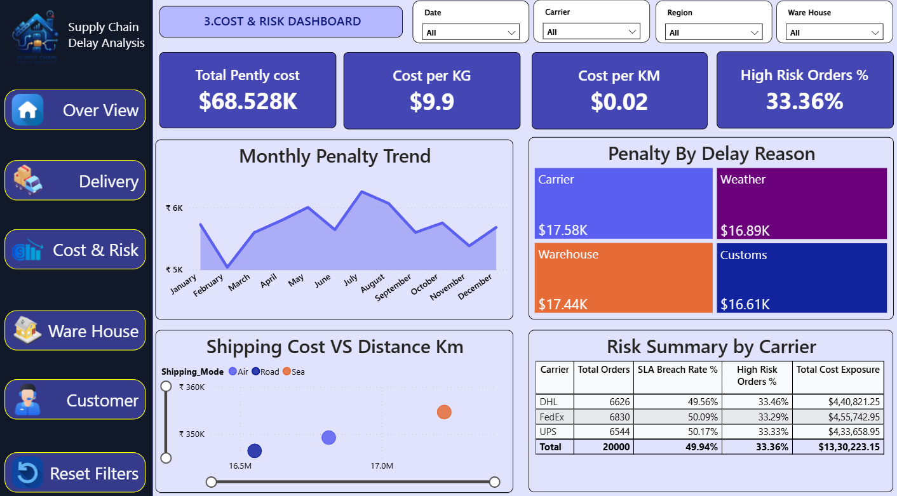
Cost and Risk Dashboard
This dashboard explains logistics cost and operational risks. • Total penalty cost is 68.5K dollars • Weather delays generated the highest penalty cost • High-risk orders are 33.36% This dashboard helps reduce financial loss and improve planning.

Slide 5
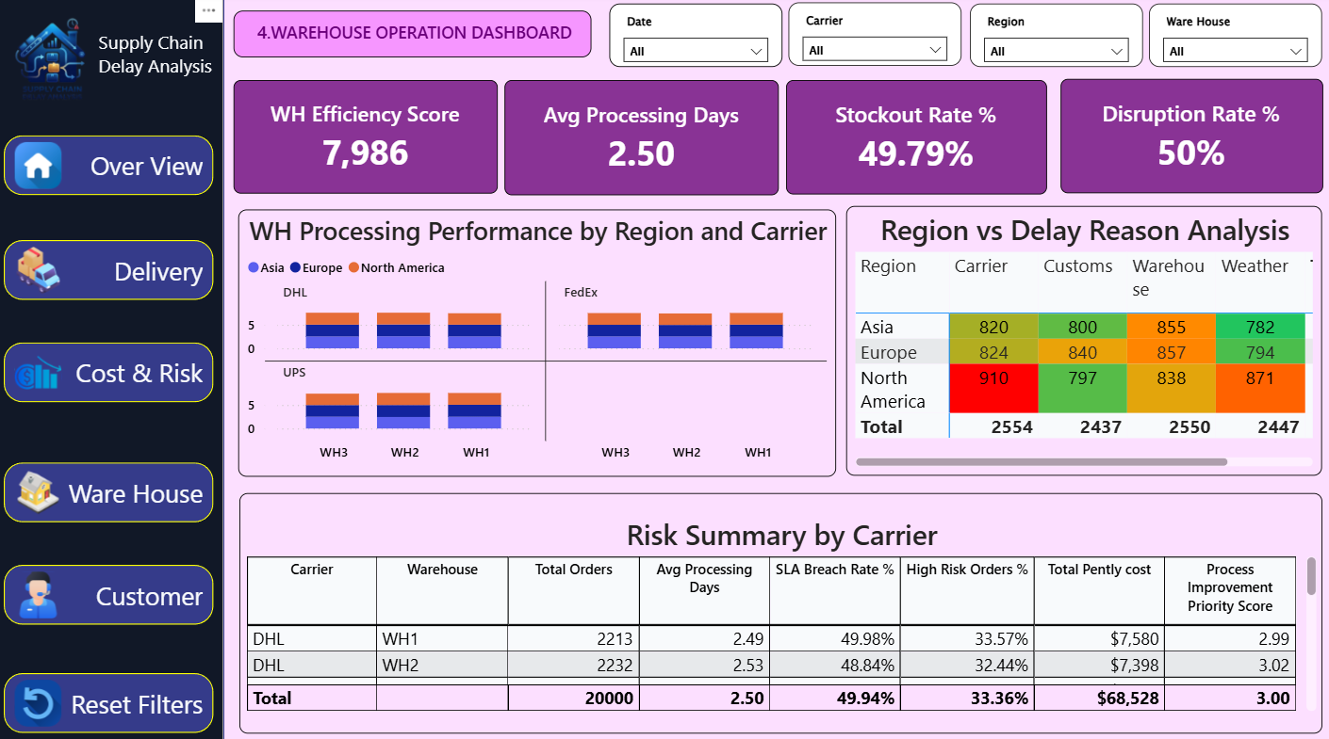
Warehouse Operation Dashboard
This dashboard analyzes warehouse efficiency. • Average processing time is 2.5 days • Stockout and disruption rates are close to 50% • North America has higher carrier delays This dashboard supports warehouse improvement decisions.

Slide 6
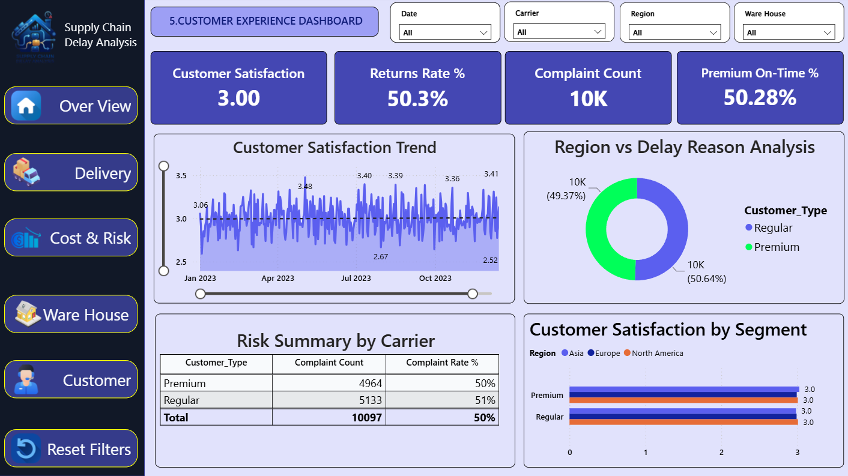
Customer Experience Dashboard
This dashboard focuses on customer satisfaction. • Satisfaction score is 3 out of 5 • Return rate is 50.3% • Complaint count is around 10K Customer satisfaction remained stable throughout the year.

Slide 7
Conclusion
To conclude, this Supply Chain Delay Analysis dashboard provides insights into delivery performance, operational risks, warehouse efficiency, and customer satisfaction.
From this analysis, we identified that weather issues, warehouse delays, and customs processing are the major reasons for delivery delays and penalty costs.
Using Power BI, the company can monitor KPIs, improve operational planning, reduce SLA breaches, and improve customer satisfaction.
Overall, this project supports better business decisions and improves supply chain efficiency.
Thank you.

